Slide 1
Secturity Lock With Intrusion Detection And Facial Recognition
By team : Technokrats
Ruchika Dubey
Bhumika Mundada
Manjushri Jiwane
Chandana Sunkara

Slide 2
Problem Statement: To design a system to identify and recognize a person/guest and Provide access based on it

Slide 3
Components Required:
Hardware Components
1.Logitech webcam
2.Raspberrypi3
3.GSM MODULE
4.Servo Motor
Software Components
Python 2.7
VNC viewer
OpenCV2

Slide 4
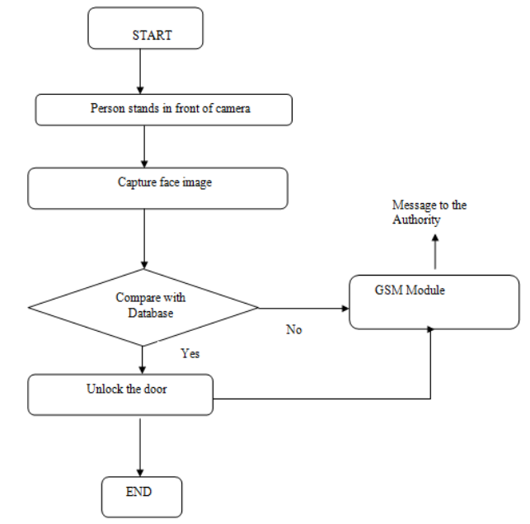
Working Of The Project

Slide 5
ADVANTAGES
It is low cost system which can be made under 5000 INR.
Using this system, the home can be monitored and controlled remotely
The system can work on both modes online and offline mode.

Slide 6
Conclusion:
Remote controlling and monitoring is possible because of Face recognition, and if someone tries to break in the user will be notified

Slide 7
Thank you !

